Slide 1
LIGHT
CONSECRATED
COMMITTED
DEATH
LIFE
DARKNESS

Slide 2
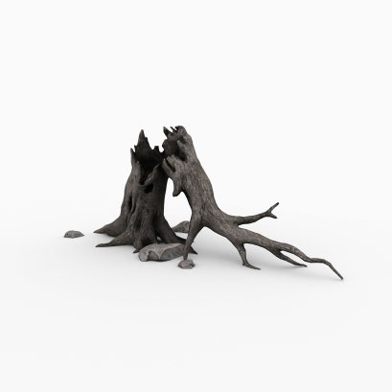
DEATH
Isaiah 5:20
Woe unto them that call evil good, and good evil
CONTRARY
DARKNESS

Slide 3
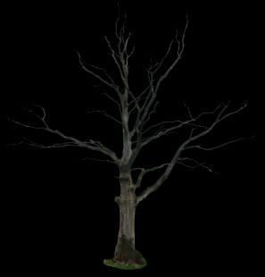
LIGHT
Ephesians 2:1
…who were dead in trespasses and sins
CONFUSED
DEATH

Slide 4
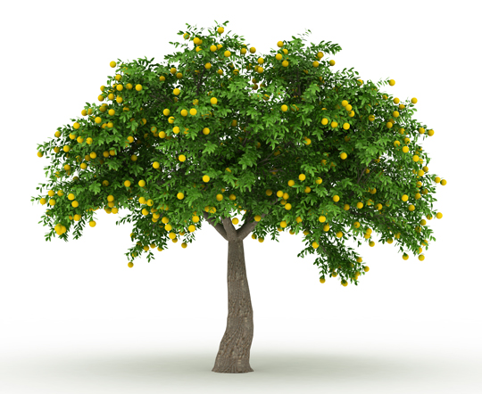
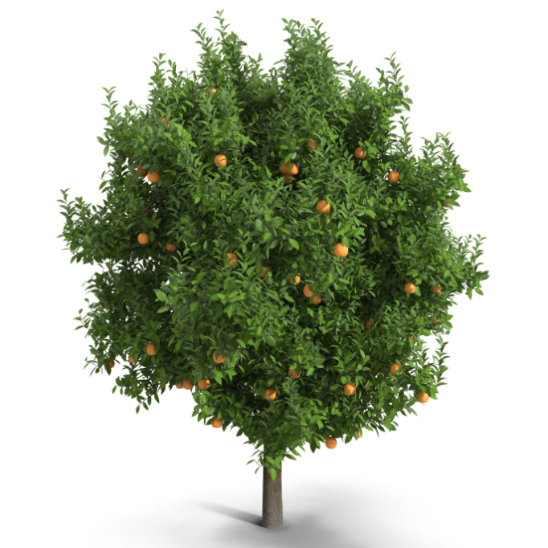
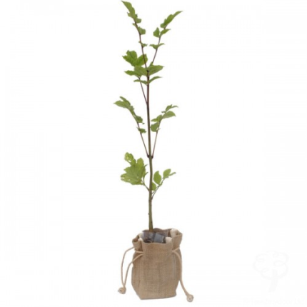
LIGHT
CONSECRATED
COMMITTED
CONVERTED
LIFE

Slide 5
LIGHT
John 1:12
But as many as received Him, to them He gave the right to become children of God..
CONVERTED
LIFE

Slide 6
LIGHT
Colossians 2:6-7
As you therefore have received Christ Jesus the Lord, so walk in Him, rooted and built up in Him and established in the faith..
COMMITTED
LIFE

Slide 7
LIGHT
CONSECRATED
Galatians 2:20
I have been crucified with Christ; it is no longer I who live, but Christ lives in me; and the life which I now live in the flesh I live by faith in the Son of God, who loved me and gave Himself for me.
LIFE

Slide 8
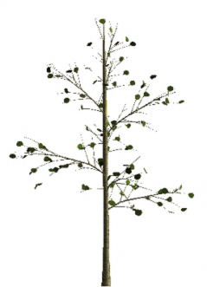
LIFE
COMPROMISED
James 5:19-20
Brethren, if anyone among you wanders from the truth, and someone turns him back, let him know that he who turns a sinner from the error of his way will save a soul from death and cover a multitude of sins.
DARKNESS

Slide 9
LIGHT
CONSECRATED
COMMITTED
CONFUSED
CONVERTED
DEATH
LIFE
CONTRARY
COMPROMISED
-
DARKNESS

Slide 10
LIGHT
CONSECRATED
COMMITTED
CONFUSED
CONVERTED
DEATH
LIFE
CONTRARY
COMPROMISED
DARKNESS

Slide 11
CONTRARY

Slide 12
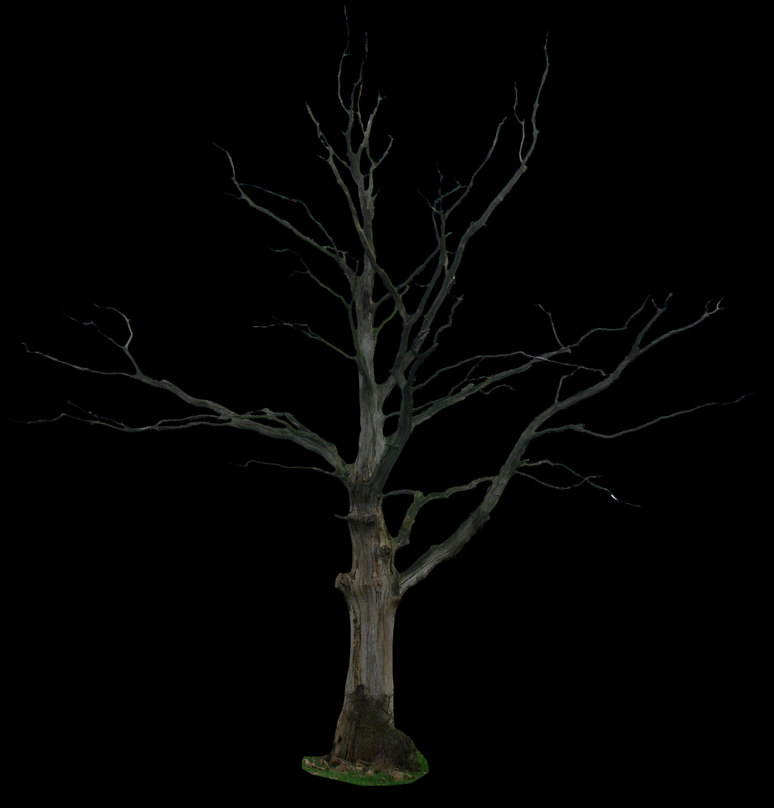
CONFUSED

Slide 13
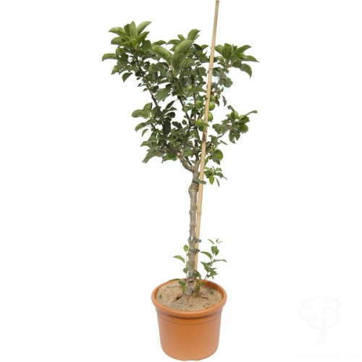
CONVERTED

Slide 14
COMMITTED

Slide 15
CONSECRATED

Slide 16
COMPROMISED

Slide 17
LIGHT
CONSECRATED
COMMITTED
CONFUSED
CONVERTED
DEATH
LIFE
CONTRARY
COMPROMISED
DARKNESS

